Slide 1
Know your Community
Yash Agarwal, Ritika Agarwal

Slide 2
Easily accessible FREE resources for you!
Power Automate (Flow)
Power Apps
Elaiza Benitez
https://www.youtube.com/channel/UCeIIWnODcCXaN-ERLzeOScA
Jon Levesque
https://www.youtube.com/channel/UClBCcDTylJUzvP8sycg6pEA
Flow Cookbook
https://flow.microsoft.com/en-us/blog/the-new-flow-cookbook-is-here/
Daniel Christian
https://www.youtube.com/user/gandolfthegr8
Todd Baginski
https://www.youtube.com/channel/UCgfWTteglpvN3wDdCx9nmhw
Power Apps Gallery
https://powerusers.microsoft.com/t5/Community-App-Samples/bd-p/AppFeedbackGallery

Slide 3
Power Apps Component Framework
Repository of open source PCF controls submitted by the community.
https://pcf.gallery/
PCF Custom Control Builder Danish Naglekar (Plugin for XRMToolbox)
Friendly UI to execute the otherwise currently available command line tools to create and deploy your PCF control.
https://www.xrmtoolbox.com/plugins/Maverick.PCF.Builder/
PCF dedicated forum
https://powerusers.microsoft.com/t5/Power-Apps-Component-Framework/bd-p/pa_component_framework
Hemant Gaur
Microsoft PM for PCF
https://www.linkedin.com/in/hemant-gaur/
PCF Gallery
Guido Priete
PCF Academy Andrii (Andrew) Butenko
https://www.youtube.com/channel/UCjXCqDkRAGFAtu2JlWr3Epg

Slide 4
Queries?
Microsoft forums for each of their Apps
Power Apps: https://powerusers.microsoft.com/t5/Forums/ct-p/PA_Comm_Forums
Power Automate: https://powerusers.microsoft.com/t5/Microsoft-Power-Automate/ct-p/MPACommunity
Power BI: https://community.powerbi.com/t5/Forums/ct-p/PBI_Comm_Forums

Slide 5
Hyderabad Power Apps and Power Automate UG
https://powerplatformug.com/Hyderabad
#PowerPlatformUG
#HYDPPUG

Slide 6
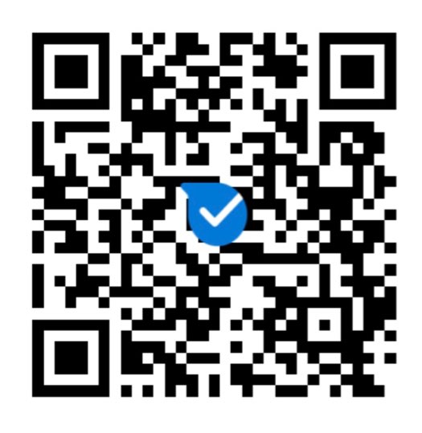
Hyderabad Power Platform UG Kaizala Group

Slide 7
Swag
Most number of tweets
Total number of tweets
Most tweeted by
Kudopalooza
Run the flow
Register to win

Slide 8
Any Questions?

Slide 9

Please fill out the survey! & Win Swags!!
https://www.powerplatformbootcamp.com/survey

Slide 10
Thank You For Attending

